Slide 1

DATABASE
TECHNOLOGIES
Parallel and Distributed Databases
Suresh Jamadagni
Department of Computer Science
and Engineering

Slide 2

DATABASE TECHNOLOGIES
Parallel and Distributed Databases
Suresh Jamadagni
Department of Computer Science and Engineering

Slide 3
DATABASE TECHNOLOGIES
Parallel Databases
A parallel database system seeks to improve performance through parallelization of various operations such as loading data, building indexes and evaluating queries
Parallel databases improve processing and input/output speeds by using multiple CPUs and disks in parallel.

Slide 4
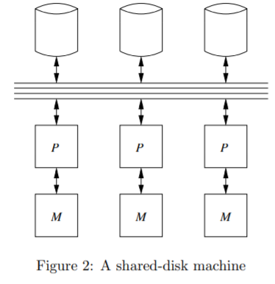
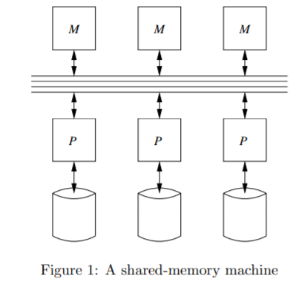
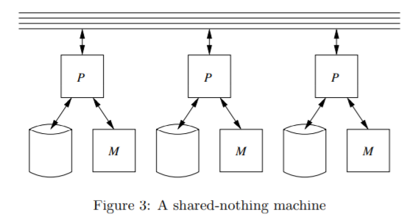
DATABASE TECHNOLOGIES
Models of Parallelism

Slide 5
THANK YOU
Suresh Jamadagni
Department of Computer Science and Engineering
sureshjamadagni@pes.edu

